Slide 1
FINAL ASSESSMENT

Slide 2

Q1.
The Individual Lead Time was obtained by the difference between the Requested Date and the Completed Date.
For Orders without the completion date, it is assumed the order is not closed and the Lead time is assigned to be 0.
With the now obtained Individual Lead values, the Average lead time is calculated and is found to be 24.038

Slide 3
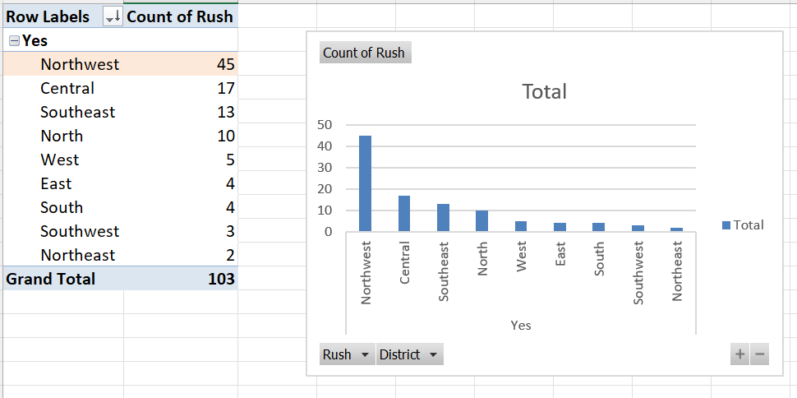
Q2.
The distinctive count was considered for Rush and Northwest District (45) was found to be the busiest district.

Slide 4
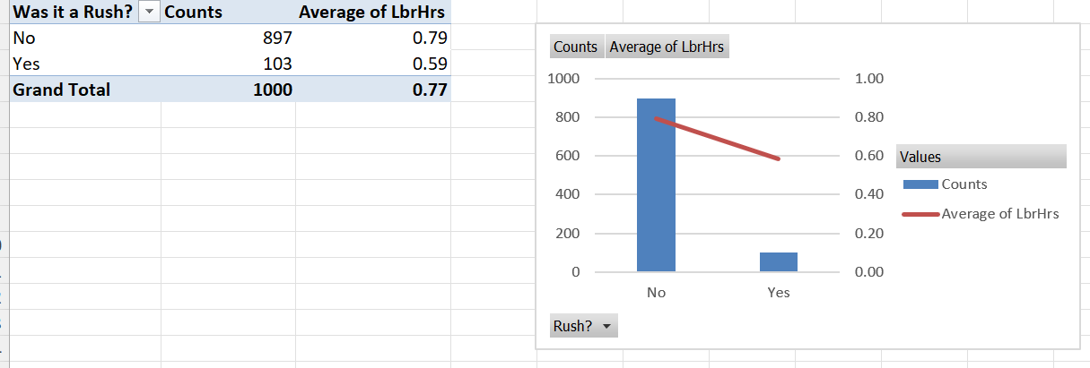
Q3.
The rushed cases have a less average of labour hours (39%) , whereas the relaxed cases have a higher average labour hours (61%).

Slide 5
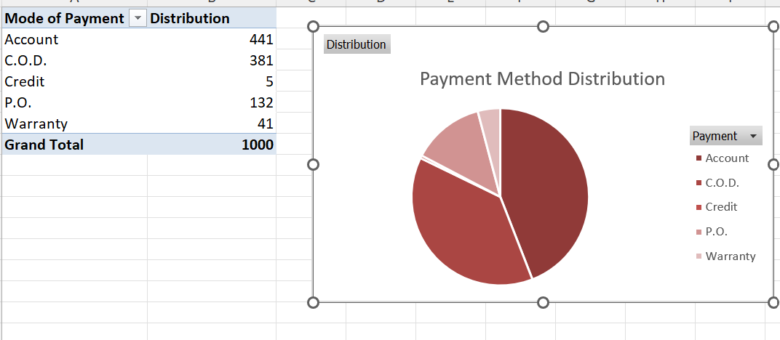
Q4.
Credit (5) is the least used method of payments and Accounts (441) is the most used method of payments.

Slide 6
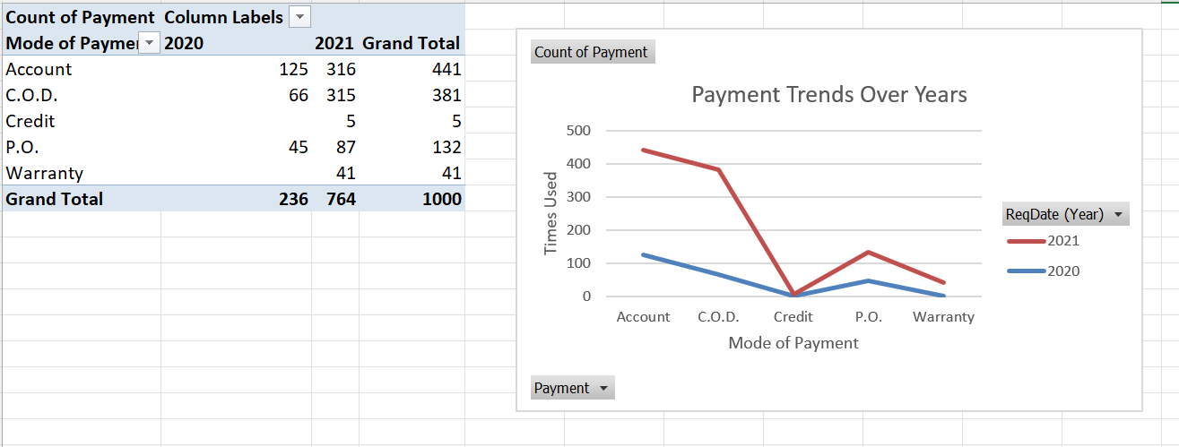
Q5.
From 2020 to 2021, there is a
Monumental increase in the account and COD method of payments.
Significant increase of P.O. and Warranty payments.
Little increase of credit card payments.

Slide 7
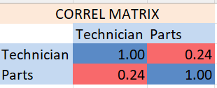
Q6.
The correlation was obtained from the master data for rows of Techs and Cost of Parts.
From the obtained matrix, it is observable that though there exists a positive correlation, it is not very strong enough to influence the whole narrative.

Slide 8
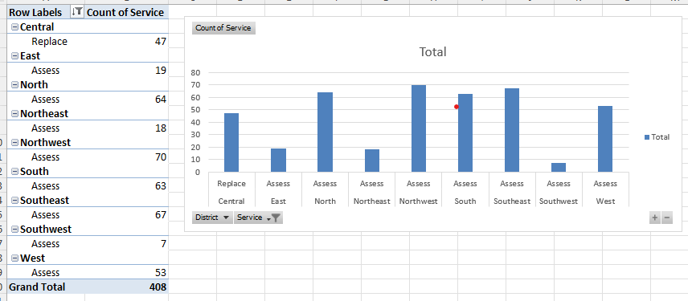
Q7.
The respective highest service orders for each district are obtained using:
Rows – District, Order Type
Values – Count of Order
And the maximum values for each district are filtered from the pivot table.
Of all, Northwest (70 Assess) has the maximum service orders and Assess has the maximum requests overall.

Slide 9
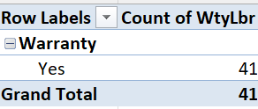
Q8.
Using Pivots, the warranty counts for labour are used.
Row – Warranty Labour
Value – Count of Warranty Labour

Slide 10
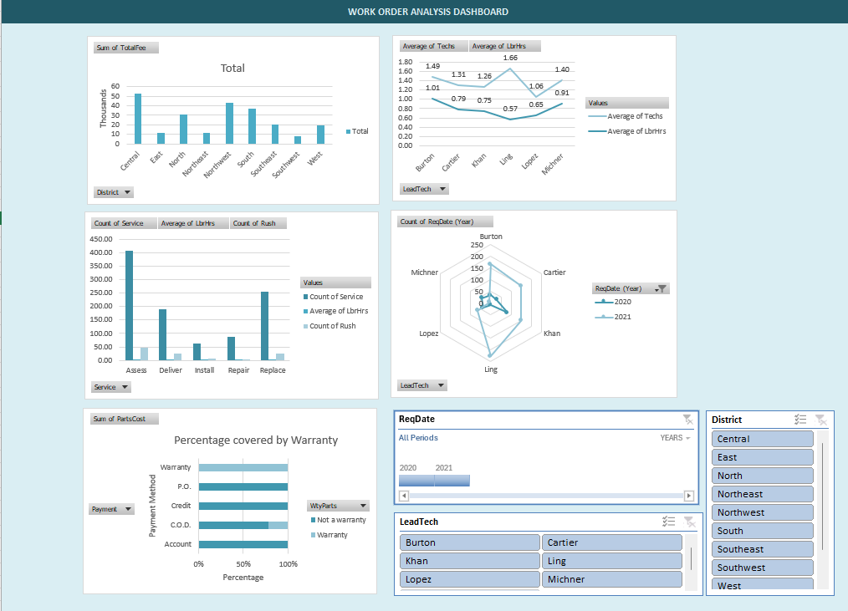
DASHBOARD
An interactive Dashboard was built for the following factors (From Top Left to Bottom Right):
Districts with Net Fees Earned.
Average Labourers used by a Team Lead
Service type and the Average Labour hours Consumed and cases of rushed ones.
Net Orders handled by a team lead for the years 2020 and 2021.
Percentage of payments Covered by warranty.
The following slicers are used:
Time period (Based on Reqdate)
Districts
Leads

